Slide 1



Project Management
Presented by
[Presenter Name Here]

Slide 2
Defining Project Management
Its Role in Achieving Business Goals
Project management is essential for aligning resources and objectives, ensuring efficient processes, risk mitigation, and stakeholder engagement, ultimately driving successful outcomes in professional environments.

Slide 3

Key Benefits of Project Management
Why Effective Management Matters
Improved efficiency in project execution
Mitigation of risks through planning
Alignment of stakeholders and goals
Structured communication across teams

Slide 4
Core Processes
Initiation Phase
Planning Phase
Execution Phase
This phase defines project goals and feasibility, ensuring alignment.
Detailed planning outlines tasks, resources, timelines, and budgets.
This phase involves implementing the project plan and managing teams.

Slide 5


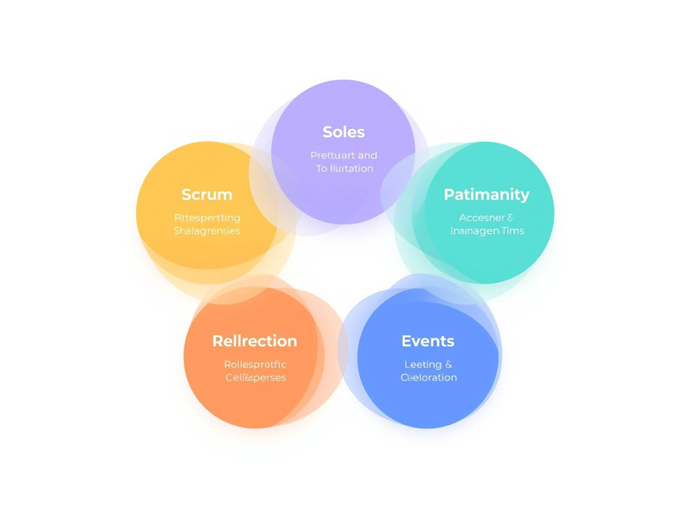
Project Management Methodologies
Waterfall
Agile
Scrum
Sequential phases ensure structured project delivery.
Flexible approach adapts to changing project needs.
Team collaboration drives successful project outcomes.

Slide 6

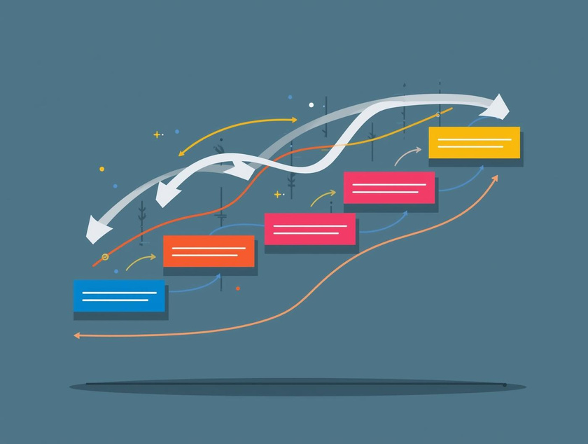

Project Management Methodologies
Kanban
Work in Progress
Team Collaboration
Visual method for managing tasks effectively.
Continuous flow of tasks enhances productivity.
Key component for successful project execution.

Slide 7
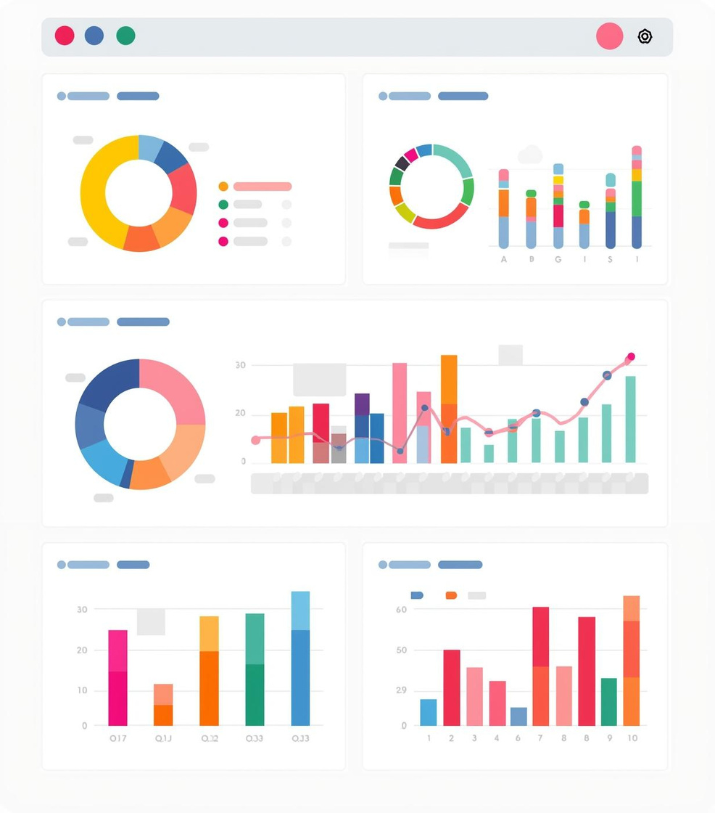


85%
92%
50%
Projects delivered on time
Team satisfaction rating
Key performance indicators tracked

Slide 8
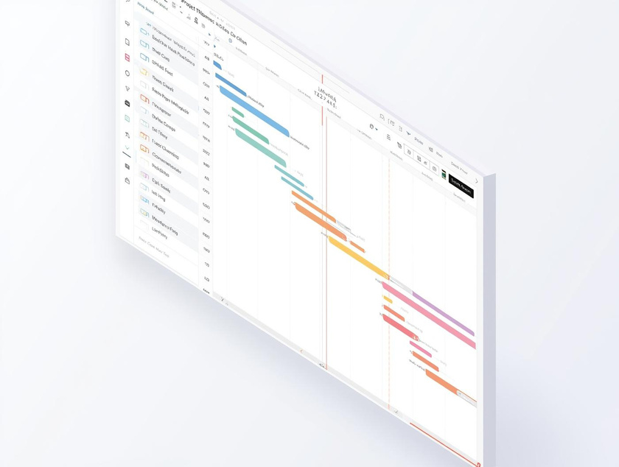


Digital Tools Overview
MS Project
Jira
Trello
A comprehensive software for detailed project scheduling.
An agile tool for team collaboration and issue tracking.
A user-friendly platform for visual project organization.

Slide 9
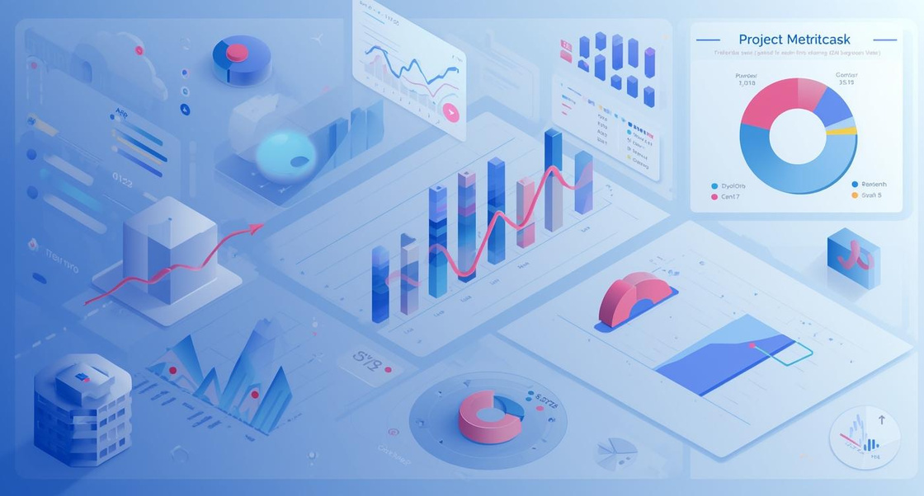

Visual Status
Understanding project status through effective data visualization is essential for clear communication with stakeholders. This page illustrates various methods to present project metrics and updates, ensuring everyone involved stays informed and aligned with the overall project goals and timelines.

Slide 10

Key Takeaways
Structured project management is essential for achieving business goals effectively. Emphasizing data-driven decision-making enhances stakeholder communication and aligns project objectives. Adopting digital tools fosters efficiency, mitigates risks, and ensures continuous improvement, ultimately leading to successful project outcomes and professional growth.

Slide 11
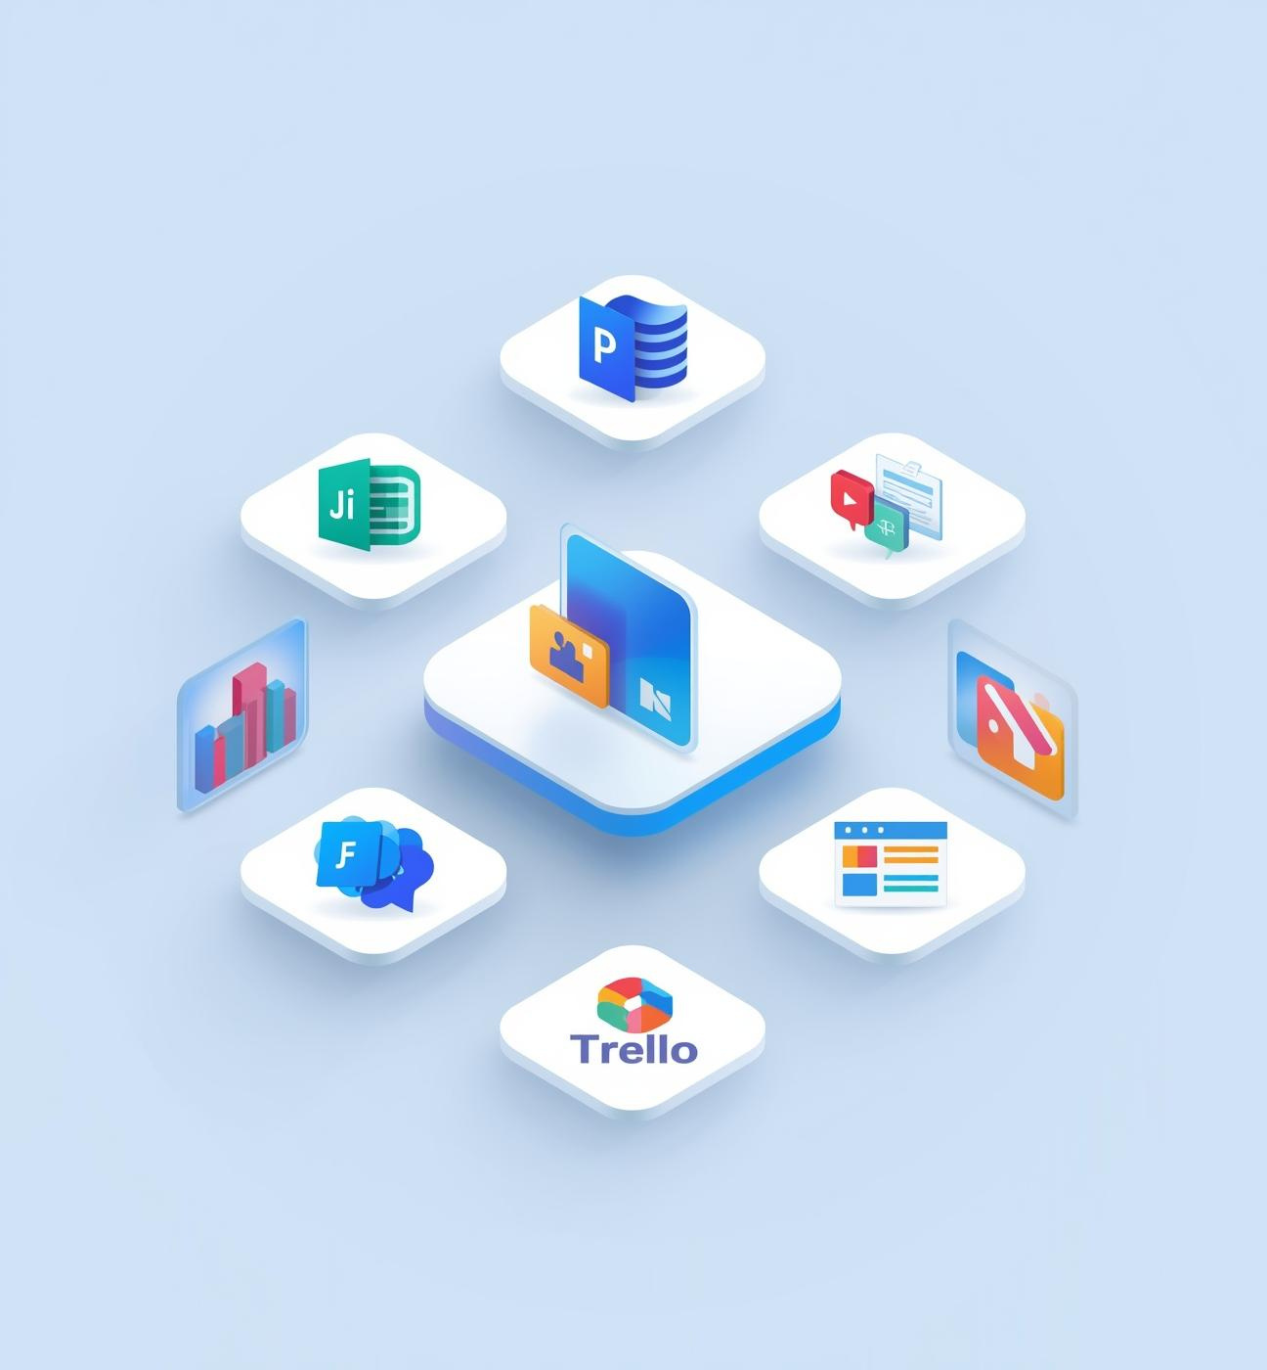
Embracing Digital Tools
Enhance Your Project Management Skills
Utilize software like Jira
Explore MS Project features
Track progress with Trello
Invest in continuous learning

Slide 12

"Schedule your priorities"
– Stephen Covey

Slide 13

Contact Us
Email
hello@reallygreatsite.com
Social Media
@reallygreatsite
Phone
123-456-7890

